Slide 1

Data geeks against opioids
PA stands together

Slide 2
Data Geeks Against Opioids PA Stands Together
TEAM CAPTAIN: Jessica Streeter, MA
Rachel Augustin, Doctoral Candidate (DrPHC)
Kelly Boettcher, MSW, LSW
Scott Pawlowski, BA
Aelesia Pisciella, Ph.D.
Manasvi Shah, MPH, MBBS

Slide 3
Data Geeks Against Opioids PA Stands Together
PROJECT DESCRIPTION: A state-wide web portal geared towards empowering all Pennsylvanians to network with local volunteer navigators, locate diverse community resources, and assess the risk of opioid misuse and abuse in communities to inform public health policies

Slide 4
Data Geeks Against Opioids PA Stands Together
INTENDED USER OR AUDIENCE:
Pennsylvanians with substance use problems: resource guide; ways to connect with other Pennsylvanians
Family members and friends: resource guide; ways to connect with other Pennsylvanians
Service providers: resource guide; county level risk assessments; ways to connect with other Pennsylvanians
Policy makers: County level risk assessments; resource guide

Slide 5
Data Geeks Against Opioids PA Stands Together
PROJECT GOAL: Centralize data sources to…
Connect individuals with other Pennsylvanians that are willing to support them in their journey
Peers, family supports, professionals, service agencies
Inform Pennsylvanians about the risks of opioid abuse/misuse in their counties
Unify access to resources like warm lines, treatment facilities, NA meetings, shelters, food banks, and other supports

Slide 6
Data Geeks Against Opioids PA Stands Together
Data Geeks, not Web Designers
An innovative way for individuals to connect with others in their area using geocoding and forms
Recommendations for PA’s open data to help facilitate this type of work
Risk modeling and identification of key factors that impact the risk of opioids
Detailed resource guide compiled from diverse datasets
https://balsamiq.cloud/syjco8p/pjaktzc

Slide 7
Data Geeks Against Opioids PA Stands Together
ArcGIS/ESRI (resource guide/local navigator map)
R (risk modeling/data cleaning & merging)
Excel (basic prep)
Balsamiq (website mockup)

Slide 8
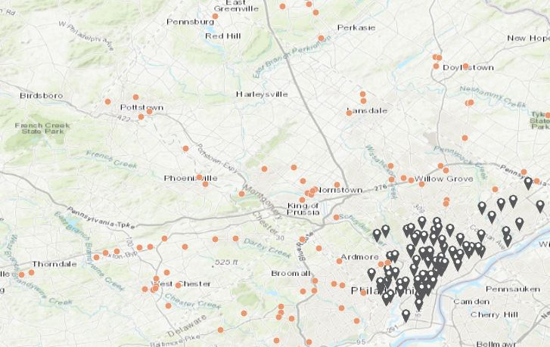
5 County Map

Slide 9
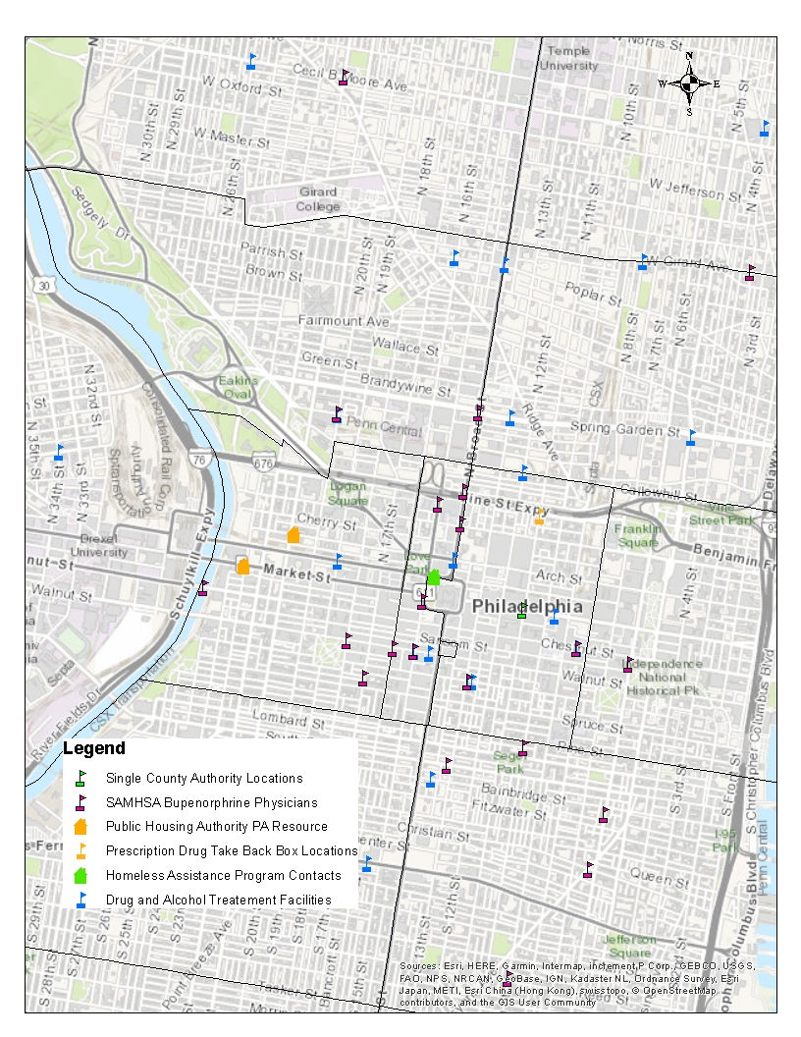
Resources by Category

Slide 10
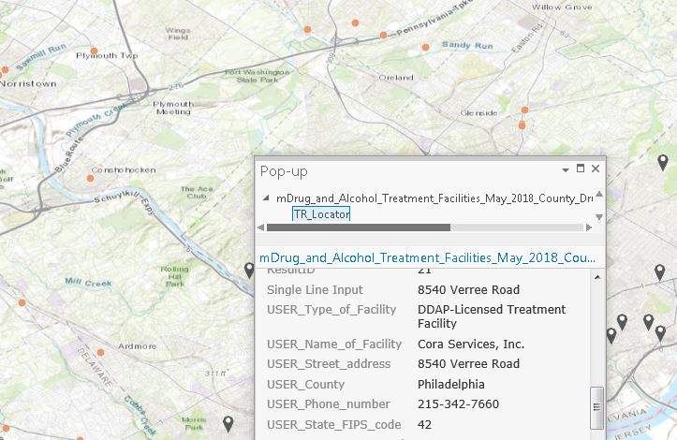
Provider Pop-Up Information

Slide 11
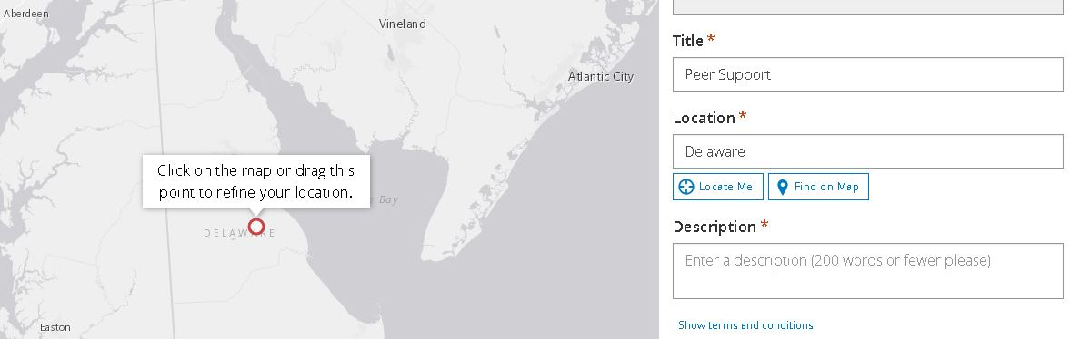
Local Navigator

Slide 12
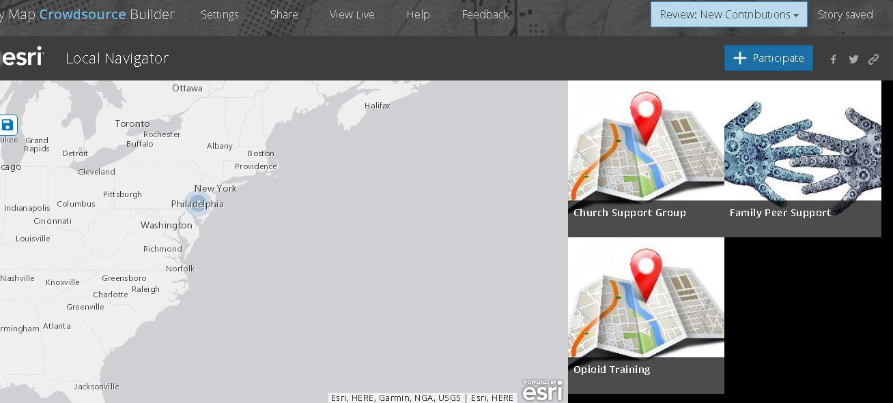
Local Navigator

Slide 13
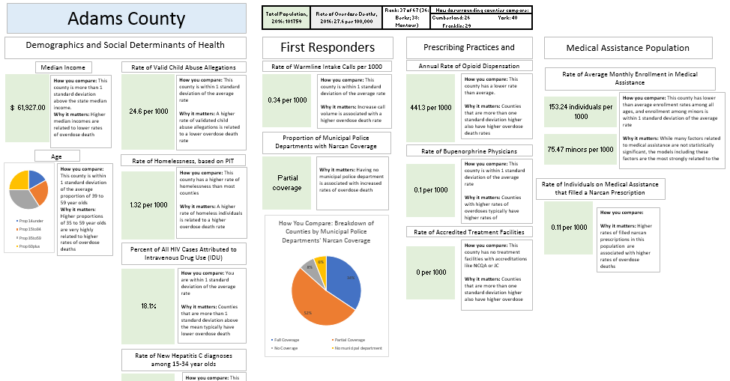
Dashboard

